Slide 1
Java Tests
By: Braden Harada

Slide 2
System Tests
Can be completed by automated software or by a human
Check the functionality of the fully assembled application
Generally by opening the user interface and checking the functionality of every line of code including erroneous uses
Often, testers do not know the software or application and are hired to test multiple pieces

Slide 3
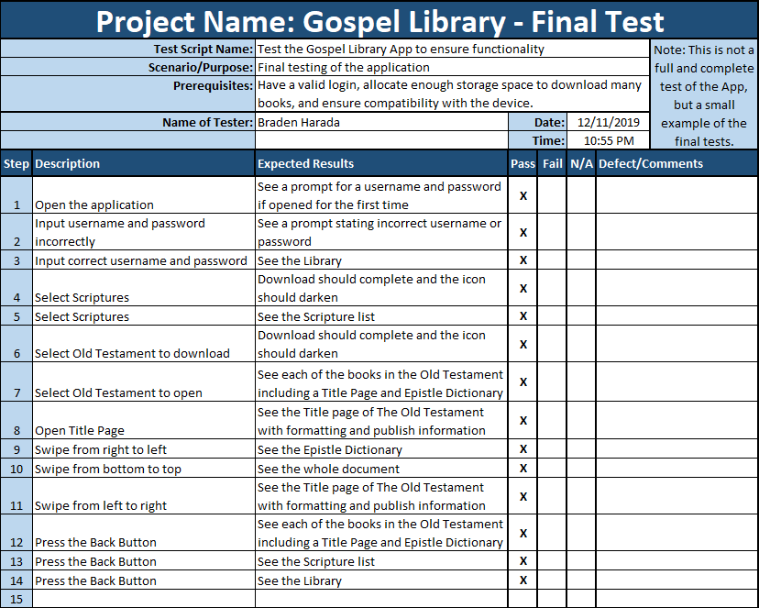
Test Template
This is a basic test template to give an idea of the basic structure of the System Tests that need to take place.
There are two columns so the tester can follow very specific steps and document the outcome of each step.
Each function of the program needs to be tested with actual and erroneous data to verify the results.

Slide 4
Different Types of System Testing
Note: There are more than 50 different types of system testing. The methods used depends on a multitude of factors. This presentation only touches on some a large corporation would generally use.
Usability Testing
Focused on ease-of-use, objectives and goals, and flexibility in handling controls
Load Testing
Ensures functionality with a heavy real-life load
Regression Testing
Ensures no changes during development caused new bugs and no old bugs recurred
Recovery Testing
Ensures clean recovery after possible crashes to verify reliability and trustworthiness
Migration Testing
Ensures compatibility with old and new system infrastructures
Functional Testing
Testers generally try to think of additional functionalities that could improve the software
Hardware/Software Testing
Focused on the interactions between the hardware and software

Slide 5
Works Cited:
Doing More With Java – Android and Tomcat Edition, Section 3, pages 9 through 12
Lee S. Barney
https://www.guru99.com/system-testing.html

